Slide 1
PROJECT TITLE
HOSPITALITY ANALYSIS

Slide 2
GROUP DETAILS GROUP NO 1
GROUP MEMBERS
Tushar Babasaheb Mali
Anirudha Surendra Kamble
Utkarsha Sanjiv Pazare
Mayuri Harinath Sonar
Ravilesetty Devi Ratnamalathi
Surjendu Naskar

Slide 3
SUMMARY OF THE PROJECT
Project Summary – Hospitality Analysis:
The Hospitality Analysis project focused on examining data from the hospitality industry to uncover key insights related to hotel bookings, guest preferences, seasonal trends, and revenue patterns. Using tools like Excel, Power BI, or Tableau, the project involved cleaning and analyzing data to identify factors affecting occupancy rates, cancellation trends, and customer satisfaction. The final dashboard visualized metrics such as booking channels, average daily rates, and guest demographics, helping stakeholders make data-driven decisions to improve operational efficiency and enhance guest experience.

Slide 4
KPI LIST
1. Total Revenue
Shows the total money earned from all hotel bookings.
2. Occupancy Rate
Tells how many rooms were booked out of the total available.
3. Cancellation Rate
Shows the percentage of bookings that were cancelled.
4. Total Bookings
Displays the total number of bookings made in a given period.
5. Utilized Capacity
Indicates how much of the hotel’s total capacity was actually used.

Slide 5
6 .Class-wise Revenue
Shows how much revenue was generated from different room types or booking classes (like Standard, Deluxe, Suite, etc.). This helps understand which room category brings in the most income.
7 . Revenue by State and Hotel
Displays how much revenue each hotel earned, grouped by state. This helps compare performance across different locations and identify high or low-performing hotels in each state.
8. Weekday and Weekend Revenue & Booking
Compares the number of bookings and revenue generated on weekdays vs. weekends. This helps understand customer behavior and peak business days.
9. Weekly Key Trends – Revenue, Total Bookings, Rating by Category
Shows how revenue, number of bookings, and customer ratings change each week. Also highlights which room or service categories are getting the best ratings over time.

Slide 6
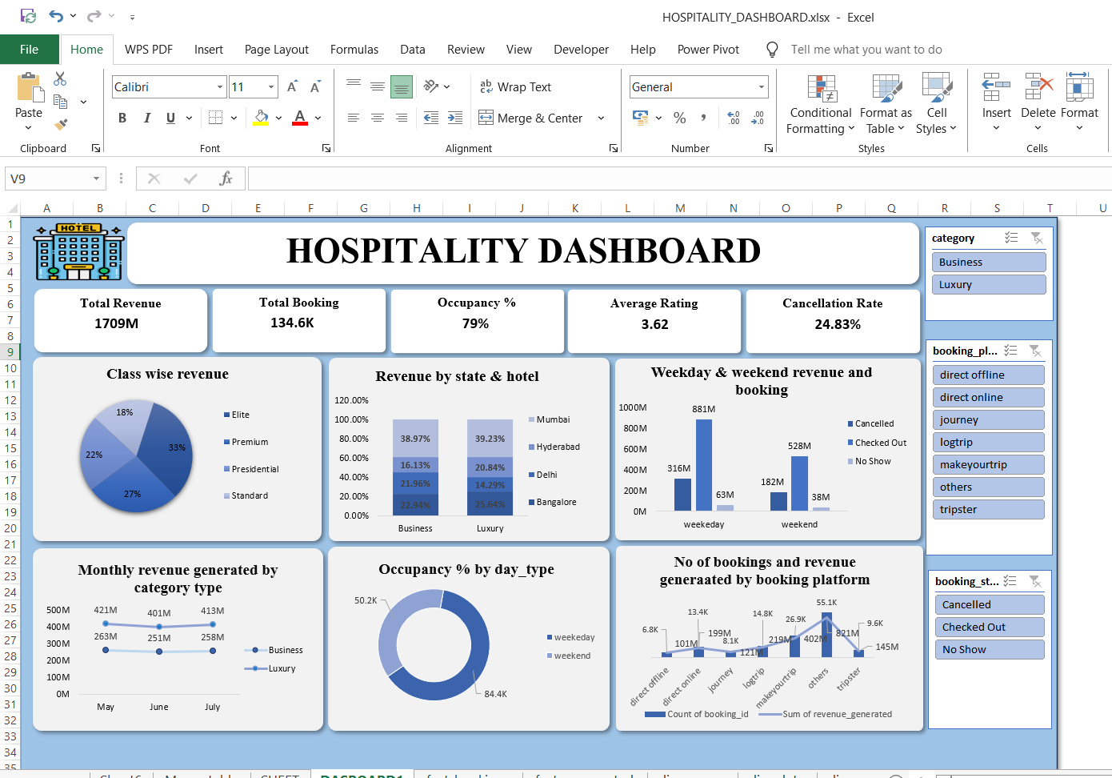
EXCEL DASHBOARD

Slide 7
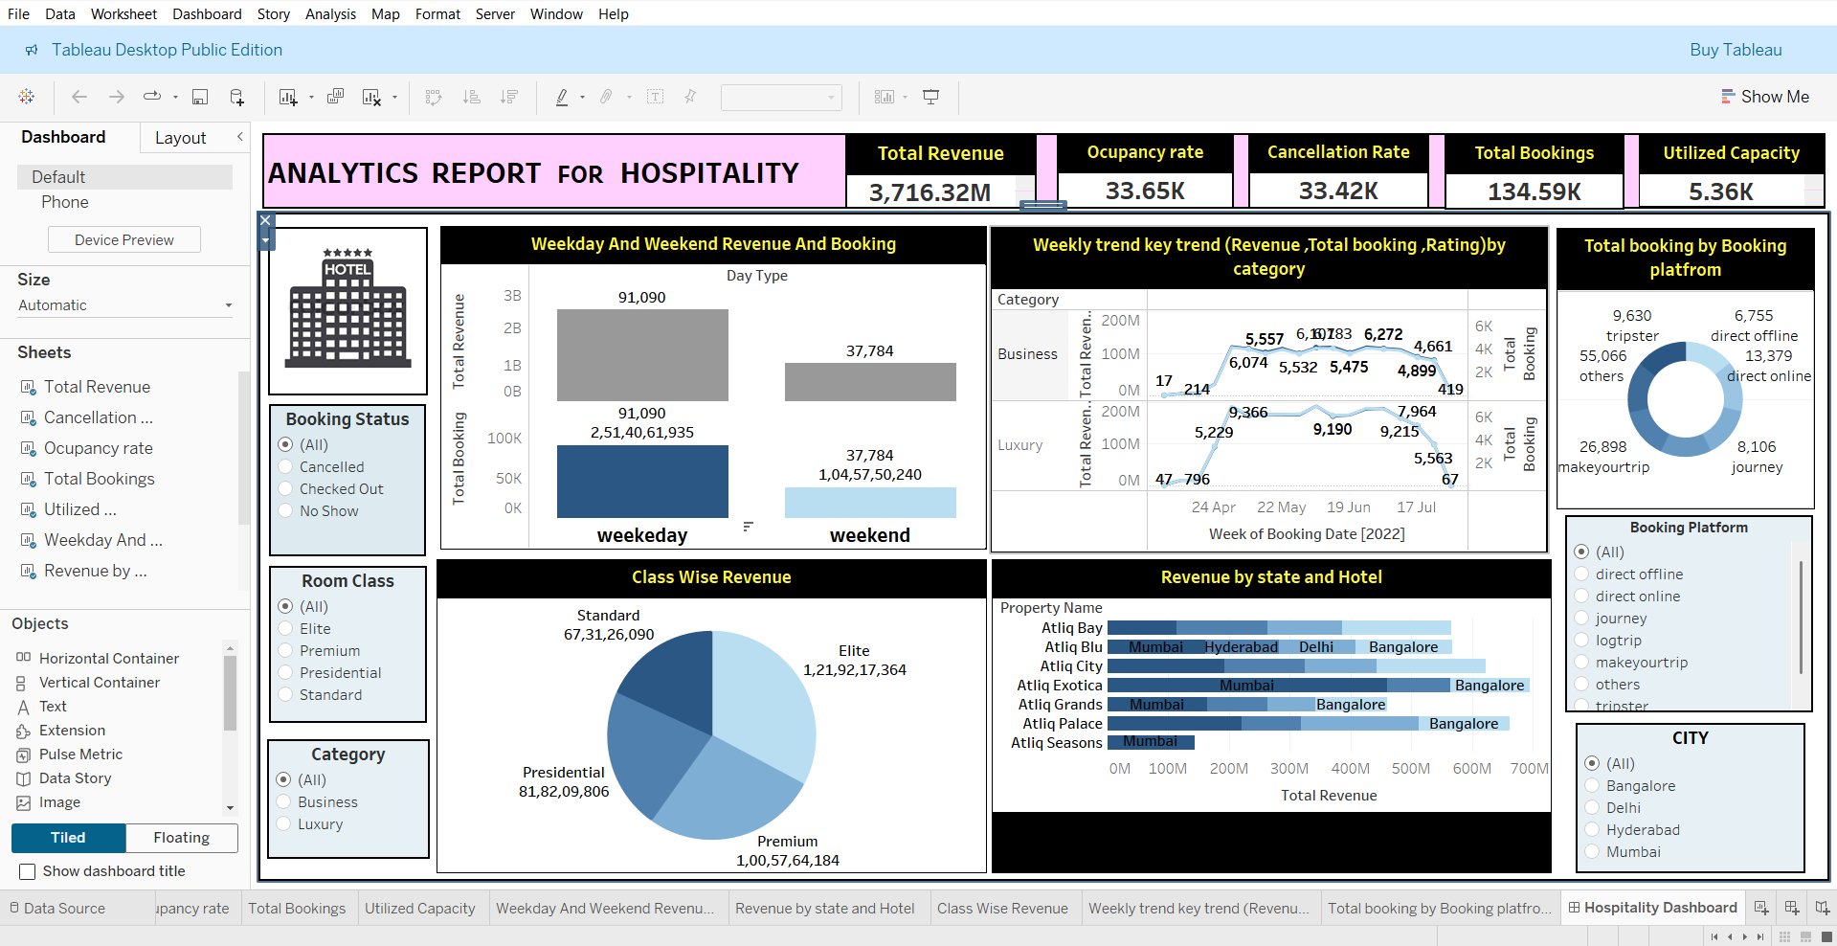
TABLEAU DASHBOARD

Slide 8
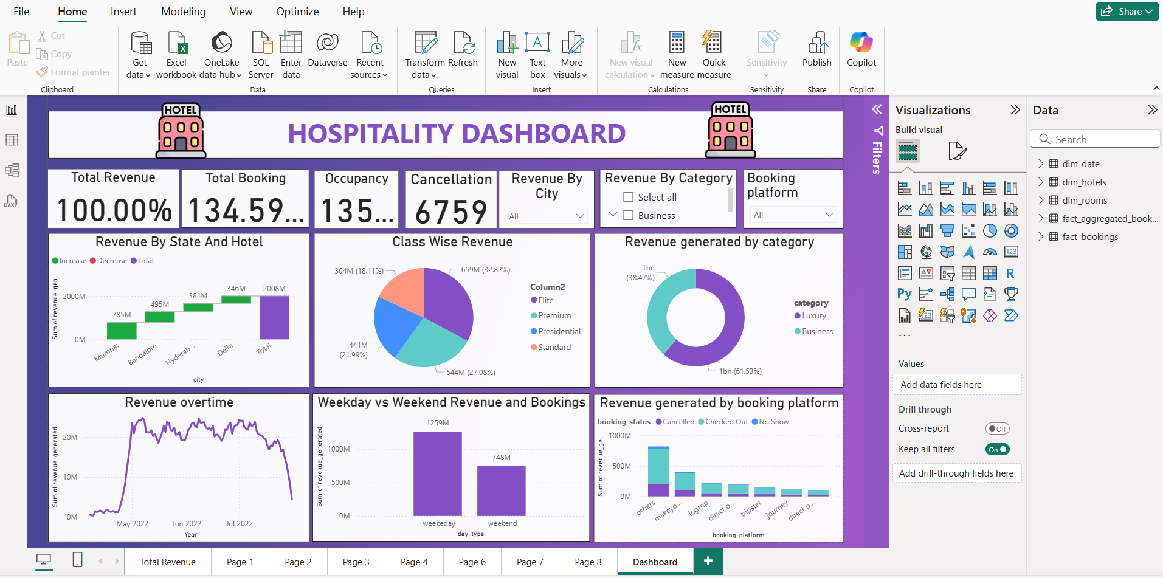
POWER BI DASHBOARD

Slide 9
SQL QUERIES
Use of SQL in the Project
SQL was used to extract, clean, and organize data from hospitality databases. It helped filter bookings, calculate revenue, group data by date, hotel, and category, and join multiple tables like customers, bookings, and payments to create a structured dataset for analysis. KPI Queries: Key performance indicators (KPIs) like total revenue, occupancy rate, total bookings, and cancellation rate were calculated using SQL queries to support data-driven insights.

Slide 10
Key Takeaway Points
Gained hands-on experience in analyzing real-world hospitality data.
Identified booking patterns, high revenue periods, and customer behavior.
Created interactive dashboards to visualize KPIs and trends.
Used SQL for data extraction, cleaning, and KPI calculations.
Compared performance across room types, hotels, and states.
Analyzed weekday vs. weekend booking and revenue trends.
Delivered actionable insights to improve hotel performance and customer satisfaction.

Slide 11
THANK YOU

